Slide 1
SemMed-Interface: A PERL Module
Andriy Mulyar
Dr. Bridget McInnes

Slide 2
The Problem
In order to help computers understand human language, they must first be able to determine how words relate to one another
Humans can quickly determine the extent to which two words are related.
The SemMed Interface, utilizing linguistic data, will provide an algorithmic means for a computer to answer this same question.

Slide 3
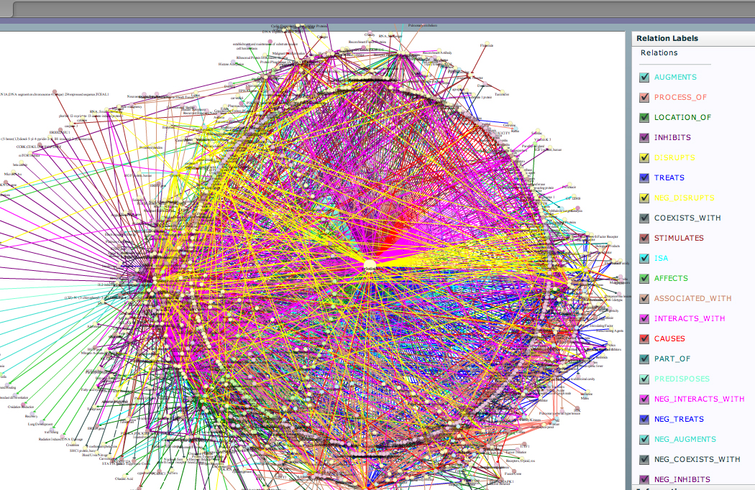
The Data: Semantic Medline Database
13,000,000+ Medical Terms.
85,000,000+ Word Relationships.
A whole lot of data.

Slide 4
The Data
Tumor Growth
Ibuprofen
AFFECTS
IS-A
TREATS
ADVIL
Myocardial Infarction
CAUSES
IS A
TREATS
Heart Arrest
Myalgia
ASSOCIATED-WITH
IS-A
CAUSED BY
Tissue Damage
Inflammatory disorder

Slide 5
The Goal
Given 2 medical terms in the database, give a score indicating how similar/associated those words are.

Slide 6
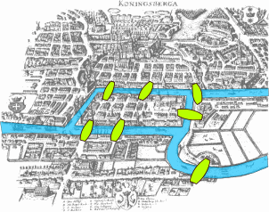
The Plan of Attack: Graph Traversal
Consider WORDS as a graph vertices
Consider WORD RELATIONSHIPS as graph edges
Consider UMLS::Association Scores as edge weights
CAUSES
Pain
Myalgia
8.7060*
*T-score

Slide 7
Calculation of Edge Weights: UMLS::Association PERL Package
The UMLS::Association package provides a PERL interface that, given 2 concepts(medical terms), returns an association score between them.
This score is a statistic calculated by analyzing word co-occurrences in large texts.

Slide 8
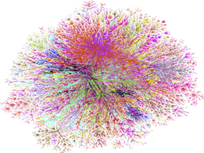
Algorithms
Breadth-First-Search (BFS)
Dijkstra's Shortest Path

Slide 9
Breadth First Search
Source: ADVIL Destination: Heart Arrest
Tumor Growth
Ibuprofen
Path Length: 3
AFFECTS
IS-A
TREATS
ADVIL
Myocardial Infarction
CAUSES
PRECEDES
TREATS
Heart Arrest
Myalgia
ASSOCIATED-WITH
IS-A
CAUSED BY
Tissue Damage
Inflammatory disorder

Slide 10
ADVIL -> Heart Arrest
Distance: 3 Terms Apart
Relatedness Score: ⅓

Slide 11
This approach isn’t perfect
Even though two concepts may be connected, the connection does not tell us how strongly associated the concepts are.
TREATS
ADVIL
PAIN
Strong Association
ADVIL
MILK
Weaker Association
CO-EXISTS WITH

Slide 12
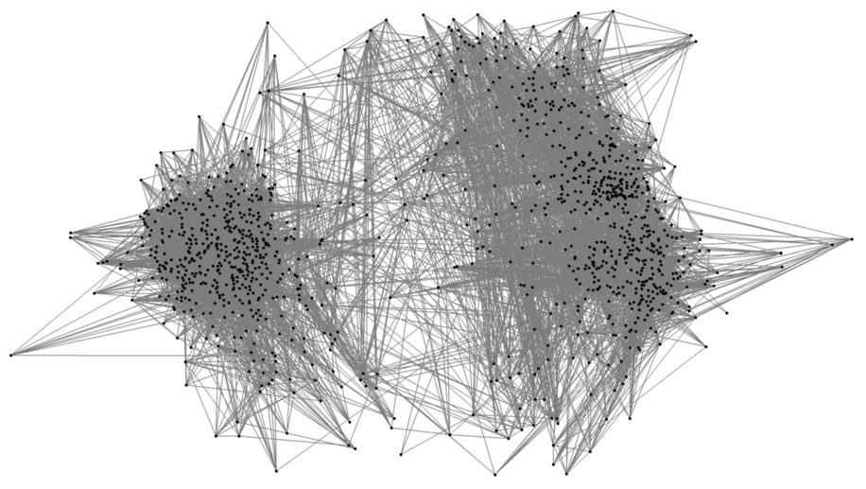
Okay...A little less than ideal

Slide 13
Assigning Edge Weights
TREATS
ADVIL
PAIN
Strong Association
3.8778
CO-EXISTS WITH
ADVIL
MILK
Weaker Association
0.2085

Slide 14
Assign Weights to the Edges
Tumor Growth
-1
Ibuprofen
1 / 7.833
AFFECTS
IS-A
TREATS
0
TREATS
-1
ADVIL
Myocardial Infarction
CAUSES
IS-A
1 / .7940
TREATS
Heart Arrest
Myalgia
ASSOCIATED-WITH
IS-A
CAUSED BY
Tissue Damage
0
1 / 2.4644
Inflammatory disorder
1 / 20.6011

Slide 15
Assign Weights to the Edges
Tumor Growth
-1
Ibuprofen
0.1276
AFFECTS
IS-A
TREATS
0
TREATS
-1
ADVIL
Myocardial Infarction
CAUSES
IS-A
1.2594
TREATS
Heart Arrest
Myalgia
ASSOCIATED-WITH
IS-A
CAUSED BY
Tissue Damage
0
0.4057
Inflammatory disorder
0.0485

Slide 16
Dijkstra's
Tumor Growth
-1
Ibuprofen
0.1276
AFFECTS
IS-A
TREATS
0
TREATS
-1
ADVIL
Myocardial Infarction
CAUSES
IS-A
1.2594
TREATS
Heart Arrest
Myalgia
ASSOCIATED-WITH
IS-A
CAUSED BY
Tissue Damage
0
0.4057
Inflammatory disorder
0.0485
1.6651
0.1761

Slide 17
Results
The scores obtained by running these algorithms between medical terms in the database were evaluated against a human produced gold standard.
Evaluation was conducted by obtaining the Spearman Rank Correlation statistic comparing the ranking of scores in the gold standard to the algorithm produced data.

Slide 18
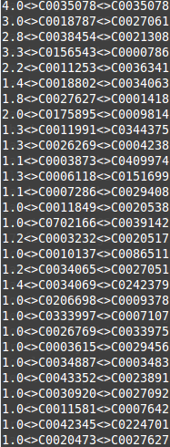
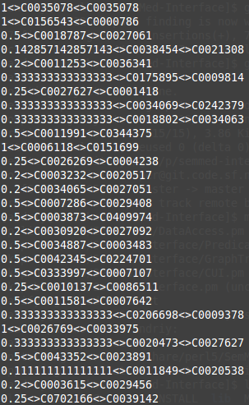
Gold Standard
Algorithm Generated

Slide 19
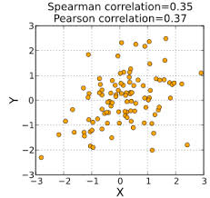
Results
Our initial set of algorithm produced data provided a low ranking coefficient when compared to the gold standard proving that just path length based aggregation would not provide enough information to determine word associativity.

Slide 20
Results
We currently plan to utilize the associativity data provided in the UMLS::Association package to gather results for further evaluation.

Slide 21
Questions

